Slide 1
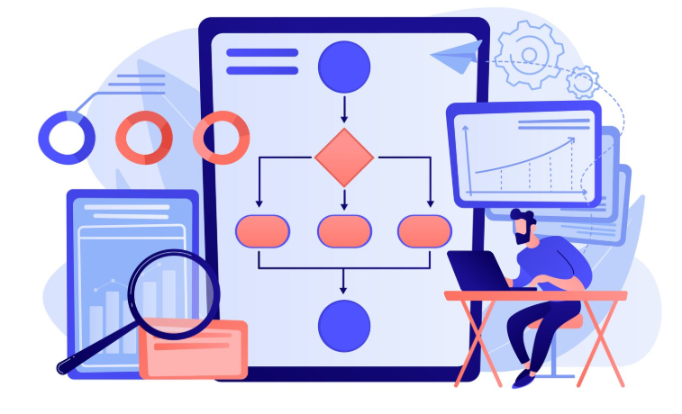
Test Automation Task
Task: Part 1- Test Automation Task
Prepared by: Chandra Prakash
Date: 17-11-2025
GitHub Repo: https://github.com/chandraprakashcp/Riverty_Automation_Task.git

Slide 2

Project Objective
To design, develop, and automate a robust acceptance test suite for the
Restful-booker Booking API, ensuring high-quality test coverage and integrating the solution into a modern CI/CD pipeline.
Key Tasks & Requirements
Test Development:
  Write acceptance tests using Cucumber/SpecFlow/.NET (Gherkin & C#) with Visual Studio or a programming language of choice
  Cover all critical APIs: GetBookingIds, GetBooking, CreateBooking, UpdateBooking.
  Utilize Scenario Outline for data-driven testing.
Execution & Reporting:
  Generate a detailed Test Execution Report after each run.
Containerization & DevOps:
  Dockerize the entire test solution for portability and consistency.
  Execute the tests automatically in a pipeline (Azure DevOps or GitLab CI).

Slide 3

Overview on what was built
Automated testing framework for Restful-Booker API
Behaviour-Driven Development (BDD) approach
Enterprise-ready with CI/CD integration
Comprehensive reporting and scalability
Technologies & Tools:
Core Language & Platform:
. C# / .NET 6
Testing Framework:
  BDD & Gherkin: SpecFlow
  Test Runner: NUnit
API & Validation:
  API Client: RestSharp
  Assertions: FluentAssertions
DevOps & Delivery:
  Containerization: Docker
  CI/CD Pipeline: GitLab CI
Reporting & Tools:
  Test Reporting: Extent Reports
  IDE: Visual Studio

Slide 4

Framework Capabilities
✅ BDD-style scenarios (Gherkin)
✅ HTML test reporting
✅ Parallel test execution
✅ Tag-based test filtering
✅ Configuration management
✅ Docker container support
✅ CI/CD pipeline ready

Slide 5

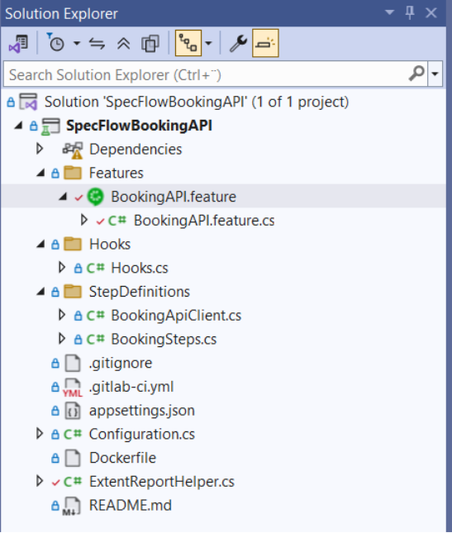
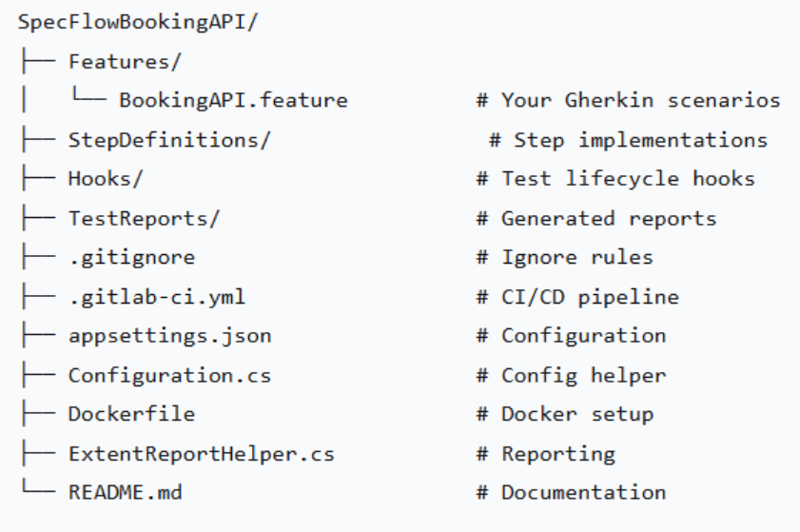
Project Structure

Slide 6
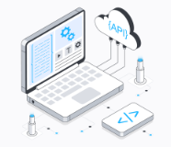
Test Coverage
API Endpoints Validated:-
GET /booking - Retrieve booking IDs
GET /booking/{id} - Get booking details
POST /booking - Create new booking
PUT /booking/{id} - Update booking

Slide 7
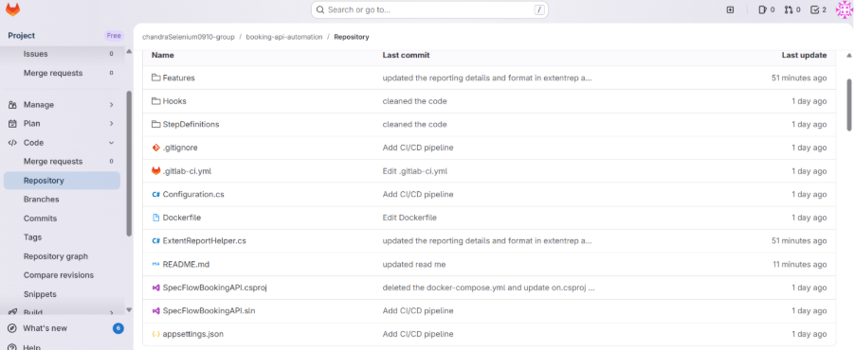
GitLab Repo

Slide 8
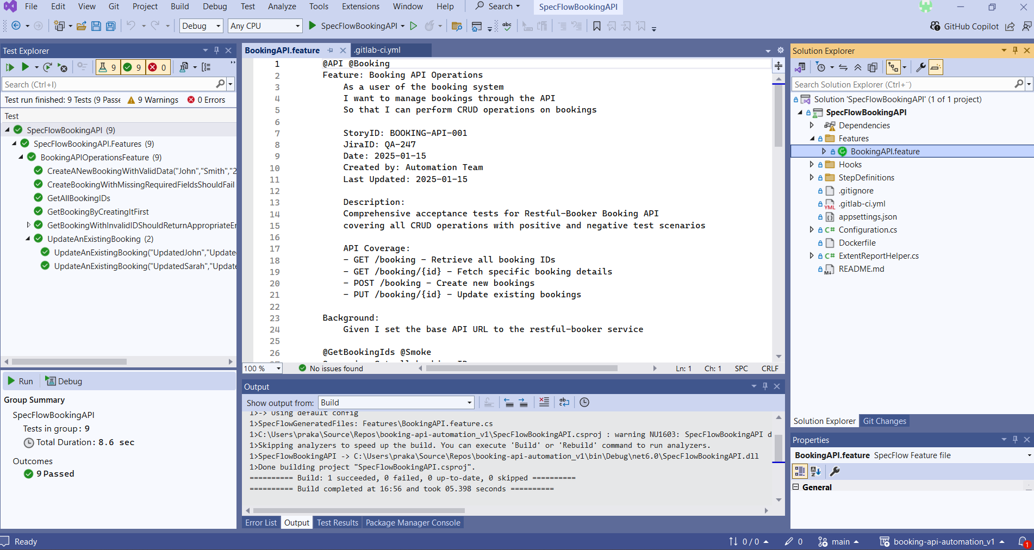
Visual Studio

Slide 9
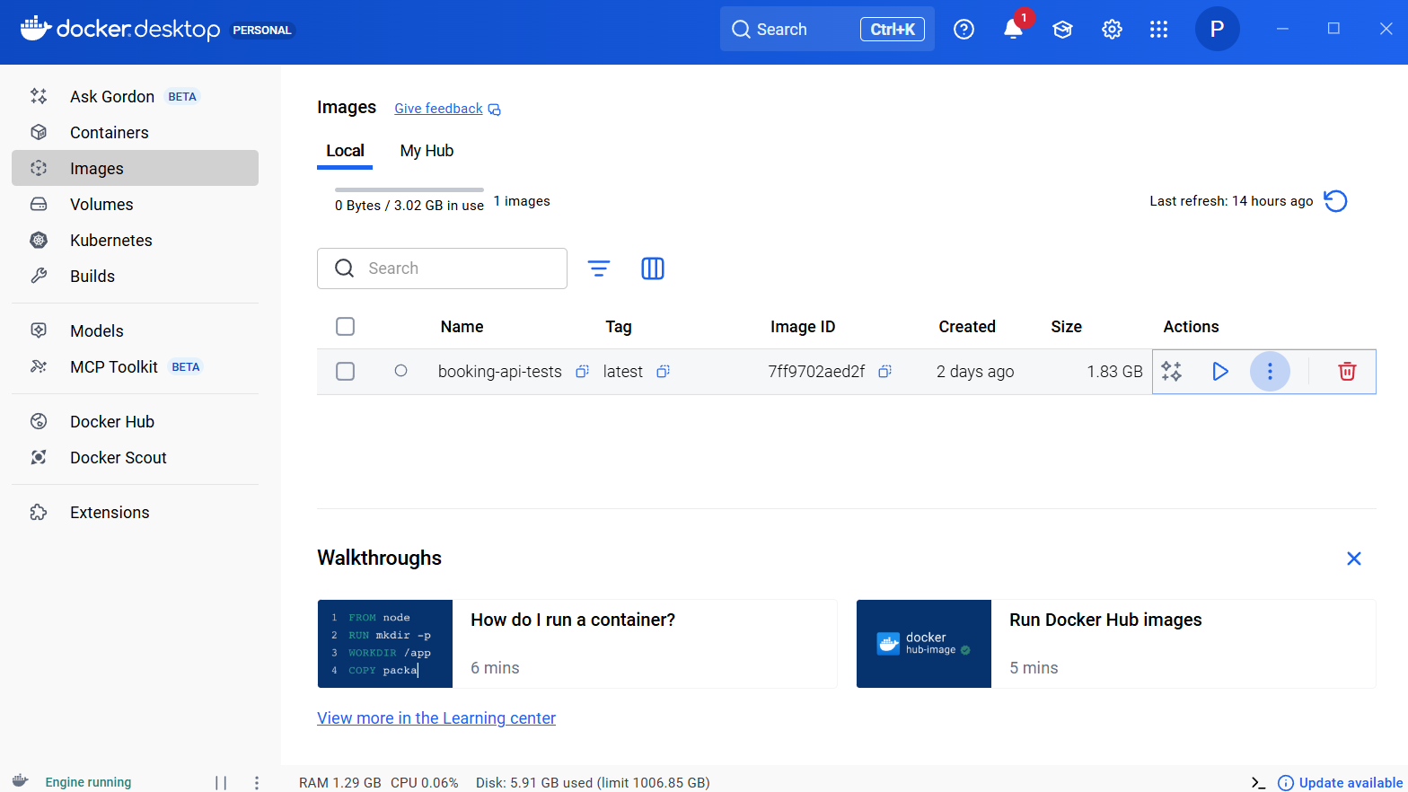
Containerized
Containerized environment
Prerequisite: Docker Desktop running
Containerized Testing
-Manual Run
Or
bash
docker build -t bookingapi-tests .
docker run bookingapi-tests

Slide 10
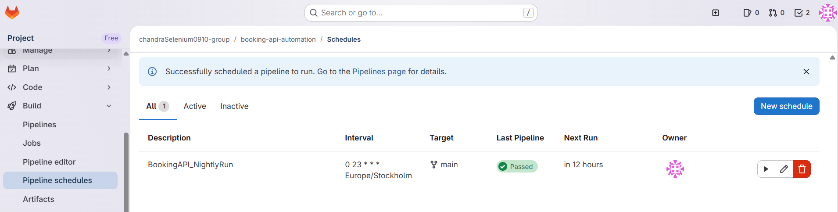
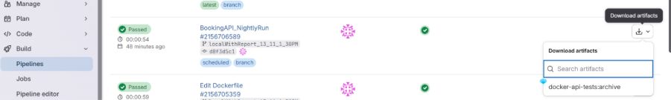
Setup and execution
Quick Setup
Clone repository
Restore dependencies: dotnet restore
Run tests: dotnet test
Generates HTML reports & test artifacts in \bin\Debug\net6.0\TestReports and Artifacts in pipeline
Pipeline schedules:
Pipelines- Run status:-

Slide 11
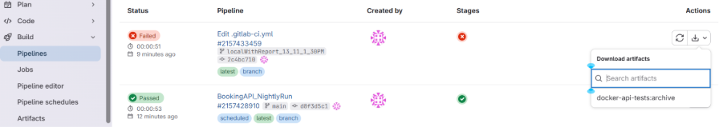
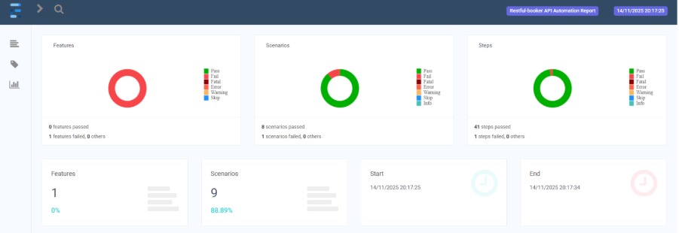
Reporting
Extent Reports Features
Feature-level grouping
Scenario-level test logs
Step-by-step execution details
Failure analysis with stack traces
Tag-based filtering
Auto-generated HTML reports

Slide 12
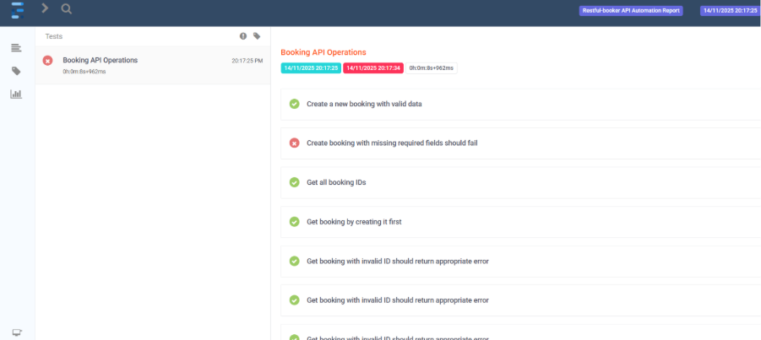
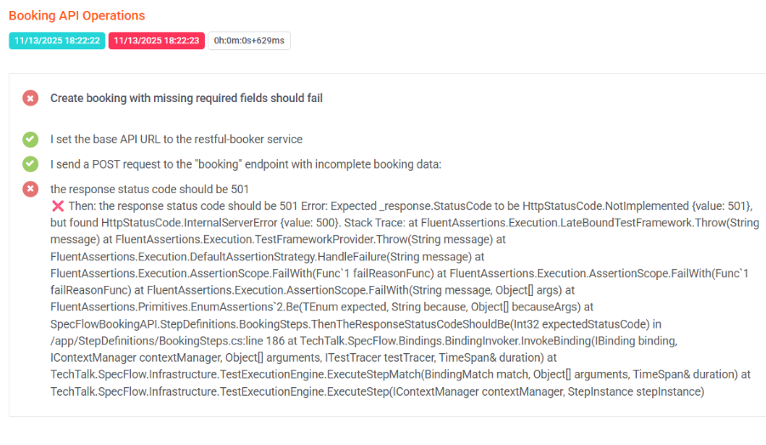
Reporting
Step-by-step execution details

Slide 13
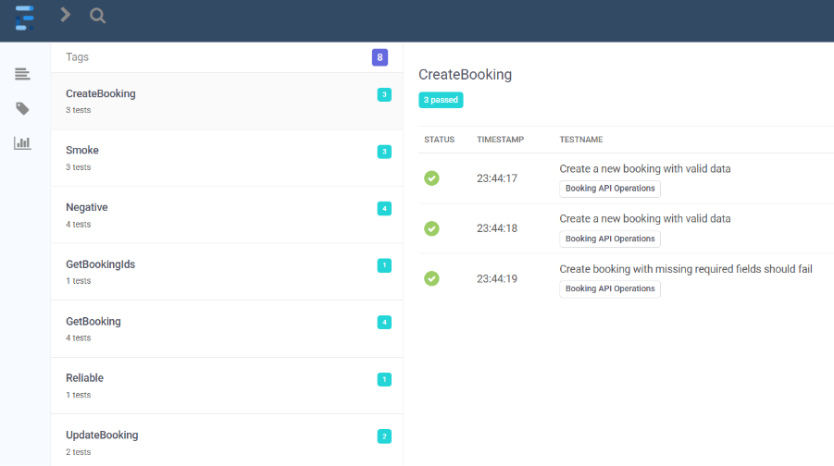
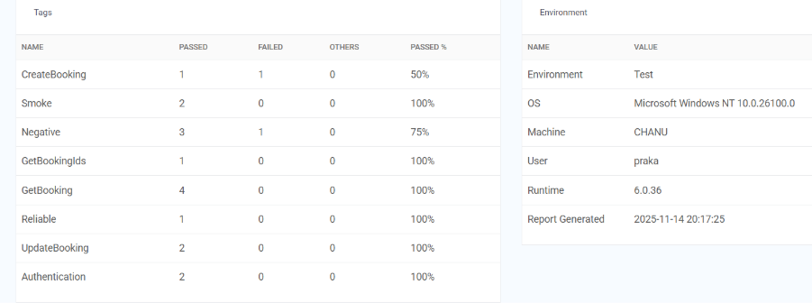
Reporting
Tag-based filtering

Slide 14

Benefits
Why This Framework?
Clean, readable tests (BDD)
Detailed reporting
Easy maintenance
Scalable architecture
Fast execution
CI/CD integration
Dockerized

Slide 15


